Slide 1
Prefixes

Slide 2
What is “prefix” ?
First of all...

Slide 3
A.接頭辞
（A word, letter, number placed before another）

Slide 4
Prefix has two meanings.
① an element placed at the beginning of a word
to adjust or qualify its meaning.
② a title placed before a name (such as Mr, Ms).
（cite: Oxford Dictionary of English )

Slide 5
culture

Slide 6
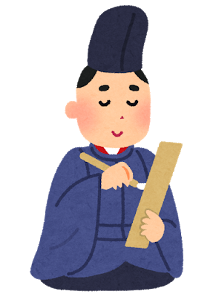
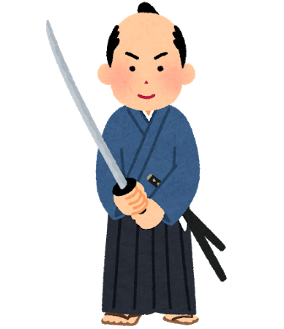
culture

Slide 7
culture
sub
HINT: sub=under～,secondary,

Slide 8
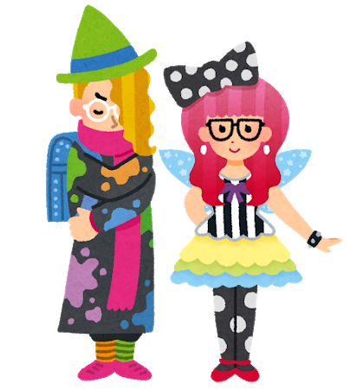

subculture

Slide 9
Con-
Pre-
Inter-
Un-
Uni-
Re-
Ex-
There are examples of prefix.

Slide 10
氵
扌
忄
飠
艹
Prefix≒部首
(Busyu…which represents an element)

Slide 11

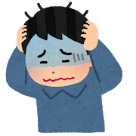
If you memorize some prefixes …
You can easily guess the meaning of the word !!（even if you don’t know its exact meaning.)
I know “happy”.
But, what is “unhappy”?
Wait...“un～”means
”the opposite”...
I get it !
“unhappy” means
“not happy” !

Slide 12
Prefix has two meanings.
① an element placed at the beginning of a word
to adjust or qualify its meaning.
② a title placed before a name (such as Mr, Ms).
（cite: Oxford Dictionary of English )

Slide 13
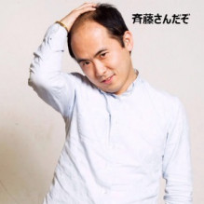
Mr. Ms. Dr.
≒～さん,～様
（Ex.斉藤さん）

Slide 14
Summary :
・ prefix=useful!!
・prefix plays an important role in representing respect.

